Slide 1
Unit 8
MANAGEMENT INFORMATION SYSTEMS 8/E
Raymond McLeod, Jr. and George Schell
Financial Information Systems;
Manufacturing Information Systems;
Marketing Information Systems;
&
Human Resources Information Systems
1-<number>
Copyright 2001 Prentice-Hall, Inc.
Notes:
1

Slide 2
Appendix D
MANAGEMENT INFORMATION SYSTEMS 8/E
Raymond McLeod, Jr. and George Schell
Financial Information Systems
D-<number>
Copyright 2001 Prentice-Hall, Inc.
Notes:
1

Slide 3
Users of Financial Information
Internal users
  Managers
  Nonmanagers
Environmental users
  Those with direct business relationships
  Those with no direct relationships
D-<number>
Notes:
2

Slide 4
Financial Information Systems
CBIS subsystem that provides information to persons and groups both inside and outside the firm concerning the firm’s financial matters
Information type
  Periodic and special reports
  Results of mathematical simulations
  Electronic communications
  Advice of expert systems
D-<number>

Slide 5
A Model of a Financial Information System
Output
subsystems
Input
subsystems
Data Information
Accounting
information
system
Forecasting
subsystem
Internal sources
Internal
audit
subsystem
Funds
management
subsystem
Users
Database
Environmental
sources
Financial
intelligence
subsystem
Control
subsystem
D-<number>
Notes:
4

Slide 6
Prewritten Financial Software
More prewritten software exists for the financial area than any other
Most is accounting in nature
Both general business and personal productivity software
D-<number>
Notes:
5

Slide 7
Accounting Information Subsystem
The foundation upon which all information-oriented CBIS are built
  Who did what?
  When?
  Where?
  How much?
D-<number>
Notes:
6

Slide 8
Internal Audit Subsystem
Internal
  Audit committee
    Probably includes the CFO
    Director of internal auditing
External auditors
Importance of objectivity
D-<number>
Notes:
7

Slide 9
Board of Directors
Audit Committee
Chief
Executive
Officer
Position of
Internal Auditing
in a Firm
Director of
Internal
Auditing
Internal
Auditing
Department
D-<number>
Notes:
8

Slide 10
Types of Auditing Activity
Financial auditing
Operational auditing
  Adequacy of controls
  Efficiency
  Compliance with company policy
Concurrent auditing
Internal control systems design
D-<number>

Slide 11
Internal Auditor as a Member of the CBIS Team
Required knowledge and skills of auditors
  Not always accounting-related
Senior management attitude makes a difference
D-<number>

Slide 12
Escalating Cost of Correcting Design Errors
as the SDLC Progresses
Operation/maintenance
4000%
Implementation
1200%
500%
Integrated testing
Relative Cost of Fixing a Defect
Module testing
100%
40%
Development
Conceptualization
10%
Design
Requirements
1%
D-<number>
Notes:
12

Slide 13
Financial Intelligence Subsystem
Represents the firm in establishing two-way links with:
Stockholders or owners
Stockholder relations department
  Annual meetings
  Annual reports
  Quarterly reports
D-<number>
Notes:
13

Slide 14
Financial Intelligence
Subsystem [cont.]
Financial community-
Indirect influence from the government
Sources of financial intelligence:
  Word of mouth
  Periodicals
  Computer databases
Environmental influence on the money flow
D-<number>
Notes:
14

Slide 15
Forecasting Subsystem
One of the oldest mathematical activities in business
  Rely on past data
  Make semistructured decisions
  Cannot be perfect
Short-term forecasts
  One to three years
  May be done by marketing
Long-term forecasts
  Usually done by finance, or special planning group
D-<number>
Notes:
16

Slide 16
Forecasting Methods
Nonquantitative (qualitative)
  Panel consensus
  Delphi method
Electronic meeting system (EMS) help combine nonquantitative and quantitative methods
D-<number>
Notes:
17

Slide 17
Forecasting Methods [cont.]
Quantitative forecasting methods
  Regression analysis is dominant
  Related methods are available
  Many software packages used
    Minitab
    IDA
    SAS
    SPSS
D-<number>
Notes:
18

Slide 18
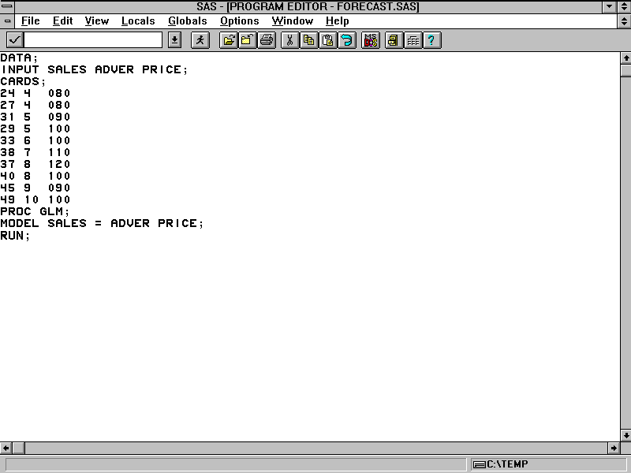
Sales Forecast Using SAS
D-<number>

Slide 19
Using the Number of Salespersons to Project Sales
4
Regression line
3
.
Sales in thousands of units
Sales prediction
2
.
.
1
.
0
5
10 15 20 25 30 35
Number of salespersons
D-<number>
Notes:
21

Slide 20
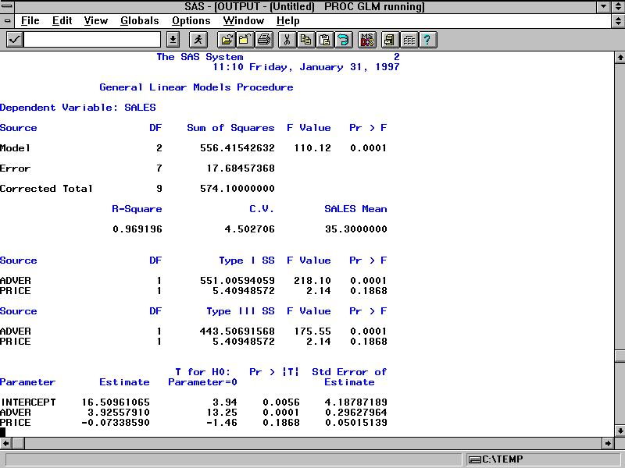
Sales Forecast Produced by SAS
D-<number>

Slide 21
Sales Forecast Data
Historical Data
Sales Advertising Price Ratio
Year (Y) (X2) (X3)
1 24 4 80
2 27 4 80
3 31 5 90
4 29 5 100
5 33 6 100
6 38 7 110
7 37 8 120
8 40 8 100
9 45 9 90
10 49 10 100
D-<number>

Slide 22
Funds Management Subsystem
Manage to achieve
  Revenue flow inflow exceeds expense outflow
  Maintain stability
Cash flow models
  Performs cash flow analysis
D-<number>

Slide 23
Unbalanced Cash Flow Example
1.2
1.1
1
0.9
0.8
Dollars (millions)
0.7
0.6
0.5
0.4
0.3
0.2
0.1
0
Jan
Feb
Mar
Apr
May
Jun
Jul
Aug
Sep
Oct
Nov
Dec
Months
Marketing and administration
expenses
Sales
Manufacturing expenses
D-<number>
Notes:
25

Slide 24
Delaying Supplier Payments Eliminates Months of Negative Sales Revenue
1.2
1.1
1
0.9
0.8
0.7
Dollars (millions)
0.6
0.5
0.4
0.3
0.2
0.1
0
Jan
Feb
Mar
Apr
May
Jun
Jul
Aug
Sep
Oct
Nov
Dec
Months
Sales
Manufacturing expenses
Marketing and administration
expenses
D-<number>
Notes:
26

Slide 25
Control Subsystem
Operating budget for the fiscal year
Three approaches
  1. Top-down
  2. Bottom-up
  3. Participative
D-<number>
Notes:
27

Slide 26
1.
Forecasting model
The Budgeting Process
Sales forecast
2.
Top
management
Approved sales forecast
3.
Resource planning
model
Finance
requirements
Human resource
requirements
Information services
requirements
Manufacturing
requirements
Marketing
requirements
4.
Finance
manager
Human resource
manager
Information
services
manager
Manufacturing
manager
Marketing
manager
Requested
finance
budget
Requested
human
resources
budget
Requested information
services budget
Requested
manufacturing
budget
Requested
marketing
budget
Top
management
5.
Final organizational
budget
D-<number>
Notes:
29

Slide 27
Example Budget Report
BUDGET REPORT
AS OF JANUARY 31 MIDWEST REGION
CURRENT MONTH YEAR-TO-DATE
ITEM BUDGET ACTUAL DOLLARS BUDGET ACTUAL DOLLARS
SALARIES $23,500 $22,000 $1,500- $59,000 $54,250 $4,750-
TRAVEL 8,250 9,000 750+ 23,500 28,100 4,600+
ENTERTAINMENT 1,400 1,635 235+ 4,200 5,100 900+
TELEPHONE 200 85 115+ 600 225 375+
RENT 535 535 0 1,605 1,605 0
FURNITURE 0 0 0 420 505 85+
SUPPLIES 625 410 215- 1,875 1,320 555-
MISC. 400 620 220+ 1,200 1,963 765+
TOTAL $34,910 $34,285 625- $92,400 $93,070 670+
D-<number>
Notes:
31

Slide 28
Performance Ratios
current assets
Current ratio =
current liabilities
cost of goods sold
Inventory turnover ratio =
average inventory value
D-<number>

Slide 29
Users of Financial Information System
Subsystem
Funds
User Forecasting Management Control
Vice-president of finance X X X
Other executives X X X
Controller X X X
Manager of accounting X
Manager of financial planning X X
Director of budgets X
Other functional managers X X X
D-<number>

Slide 30
Summary
Financial information systems provide a wide range of information for both managers and interested external people
Uses include:
  Auditing
  Financial intelligence
  Forecasting
  Funds management
  Budgeting
Financial modeling is one of the oldest uses of mathematical simulations in business
D-<number>

Slide 31
Appendix C
MANAGEMENT INFORMATION SYSTEMS 8/E
Raymond McLeod, Jr. and George Schell
Manufacturing Information Systems
C-<number>
Copyright 2001 Prentice-Hall, Inc.
Notes:
1

Slide 32
Manufacturing Information System
Used to support efforts to produce products
Evolution of computer use in manufacturing
  Systems keyed on reorder points
  MRP
  JIT
Consists of three input and four output subsystems
C-<number>

Slide 33
The Computer as Part of the Physical System
Focuses on computer-controlled machines in the production area
  CAD (computer-aided engineering)
  Design database
  CAM (computer-aided manufacturing)
  Robotics
C-<number>
Notes:
2

Slide 34
The Computer As an
Information System
Term “manufacturing information system” used to describe the CBIS subsystem that provides information concerning the production operations
Goes by many other names
  ROP, MRP, MRP II
  JIT, CIM
C-<number>
Notes:
3

Slide 35
Reorder Point (ROP) Systems
Key Terms
  Reorder point, stockout, lead time, safety stock
ROP formula: R = LU+S
Still used by many firms
  Well suited to retail inventories
C-<number>
Notes:
3

Slide 36
Reorder Point With No Safety Stock
and With a Safety Stock
Reorder point
Balance
on hand
A. No safety stock
Lead time
Time
Balance
on hand
Safety stock
B. Safety stock
C-<number>

Slide 37
Material Requirements
Planning (MRP)
Looks to the future and identifies the materials needed
Components:
  1. Production scheduling system -- produces a master production schedule that encompasses the longest lead time plus the longest production time.
  2. MRP system -- explodes the bill of materials. Converts the gross requirements into the net requirements.
C-<number>
Notes:
6

Slide 38
Material Requirements
Planning (MRP)
Components (cont.):
  3. Capacity requirements planning system works with MRP system to keep production within plant capacity. Produces outputs: reports and planned order schedule.
  4. Order release system produces reports for shop floor and purchasing.
C-<number>
Notes:
7

Slide 39
An MRP System
Purchasing
system
Bill of
material
file
3. Capacity
requirements
planning
Customer
order file
Sales
forecast
file
Order release
report
1.Production
scheduling
system
2. Material
requirements
planning system
Planned
order
schedule
4.Order
release
system
Finished-
goods
inventory
file
Master
produc-
tion
schedule
Planning reports
Order release
report
Produc-
tion
capacity
file
Performance reports
Raw
materials
inventory
file
Exception reports
Changes to
planned orders
Shop floor
control
system
C-<number>
Notes:
8

Slide 40
Manufacturing Resource Planning (MRP-II)
The purpose is to integrate MRP with all systems that affect materials management
  Organizational systems
  Accounting information system
C-<number>
Notes:
9

Slide 41
An MRP II System
Other functional
information systems
Executive
information
system
Order
entry
Purchasing
Material
requirements
planning
Billing
Receiving
Accounts
receivable
Accounts
payable
General
ledger
C-<number>
Notes:
10

Slide 42
MRP-II Benefits
More efficient use of resources
  Reduced inventories
  Less idle time
  Fewer bottlenecks
Better priority planning
  Quicker production starts
  Schedule flexibility
C-<number>
Notes:
11

Slide 43
MRP-II Benefits [cont.]
Improved customer service
  Meet delivery dates
  Improved quality
  Lower price possibility
Improved employee moral
Better management information
C-<number>
Notes:
12

Slide 44
Just-In-Time (JIT)
Faster material flow
Small lot size
Timing
Compare JIT to online processing and MRP to batch
Kanban pulls material as opposed to MRP push
Computer not emphasized
C-<number>
Notes:
13

Slide 45
Manufacturing Information System
Definition
  A computer-based system that works in conjunction with other functional information systems to support the firm's management in solving problems that relate to manufacturing the firm's products
C-<number>
Notes:
14

Slide 46
A Model of a Manufacturing System
Output
subsystems
Input
subsystems
Data Information
Accounting
information
system
Production
subsystem
Internal
sources
D
A
T
A
B
A
S
E
Inventory
subsystem
Industrial
engineering
system
Users
Quality
subsystem
Environmental
sources
Manufacturing
intelligence
subsystem
Cost
subsystem
C-<number>
Notes:
15

Slide 47
Accounting Information
System [AIS]
Data collection terminals
  Track material flow
  Gather job data (job reporting)
  Gather attendance data (attendance reporting)
C-<number>
Notes:
16

Slide 48
Location of
Data Collection Terminals
Receiving area
1
Receiving
Terminal
inspection
2
Raw-materials
storeroom
3
4
5
6
8
Shop floor area
9
7
10
Finished-goods
storeroom
11
Shipping area
12
C-<number>
Notes:
17

Slide 49
Industrial Engineering Subsystem
The industrial engineer (IE)
Studies physical and conceptual systems
Sets production standards
C-<number>
Notes:
18

Slide 50
Manufacturing Intelligence Subsystem
Can be viewed in terms of environmental contacts
Labor unions (personnel flow)
  Formal and informal systems
  Personnel information
  Union contract compliance
Suppliers (material and machine flow)
C-<number>
Notes:
19

Slide 51
Flow of Labor Information
Industrial relations
department
Strategic level
management
Labor Unions
Union contract
performance
Government
Personnel
requests
Suppliers
Employment
agencies
College &
universities
Trade schools
Human
resources
department
Manufacturing
management
Applicant
data
Global
community
Competitors
Formal flow
Employees
Informal flow
C-<number>
Notes:
20

Slide 52
Input to Supplier Records
Supplier
input
Financial strength, quality control
emphasis, past quality and delivery
performance, and so on
Supplier
file
Quality
control input
Units rejected upon receipt, units
rejected during production,
reasons for rejection, and so on
Customer
service input
Units replaced or repaired because
of defective parts, supplier spare
parts availability, and so on
C-<number>
Notes:
22

Slide 53
Production Subsystem
Used to:
  1. Build production facilities
  2. Operate production facilities
Production schedule determines when the production steps are performed
Track expected and actual completion times
C-<number>
Notes:
23

Slide 54
Job Flow Through the Plant
Plastic top
Step 5
Install bulb
Raw
materials
inventory
Plastic
cylinder
Step 6
Install reflector
Attach switch
Step 7
Install red lens
Step 2
Step 1
Attach spring
Step 8
Install clear lens
Step 3
Step 4
Step 9
Put top on
cylinder
Attach strap
Add batteries
Flashlight
PRODUCTION AREA
Finished
goods
inventory
C-<number>

Slide 55
Inventory Subsystem
Importance of determining the inventory level
Maintenance cost (carrying costs)
Purchasing costs
Economic Order Quantity (EOQ)
Economic manufacturing quantity (EMQ)
C-<number>
Notes:
25

Slide 56
The Effect of Order Quantity on Average Inventory Level
25
Balance on hand
Average inventory level
15
---------------------------------------------------
5
Safety stock
0
Time
A. Order quantity of 20; average level is 15.
21
Balance on hand
13
Average inventory level
------------------------------------------------------
5
0
Safety stock
Time
B. Order quantity of 16; average level is 13.
C-<number>
Notes:
26

Slide 57
Quality Subsystem
Deming’s fourteen points; maintained that it is not workers but management that determines quality
Total quality management (TQM)
Elements of TQM
  Zero defects
  Quality at the source
C-<number>
Notes:
27

Slide 58
Total
Quality
Management
TQM Philosophy
*Customer-driven
quality standards
*Customer-supplier
links
*Prevention
orientation
*Quality at the
source
*Continuous
improvement
Graphical Tools
*Process flowcharts
*Check sheets
*Pareto analysis
and histograms
*Cause and effect
(fishbone) diagrams
*Run charts
*Scatter diagrams
*Control charts
Statistical Tools
*Sampling plans
*Process capability
*Taguchi methods
C-<number>

Slide 59
Cost Subsystem
Periodic reports
Required ingredients
  1. Standards
  2. Information
C-<number>
Notes:
30

Slide 60
How Managers Use the
Manufacturing Information System
Subsystem
User Inventory Quality Production Cost
Vice president of manufacturing
X
X
X
X
Other executives
X
X
X
Plant Superintendent
X
X
X
X
Manager of planning and control
X
X
Manager of Engineering
X
X
X
Manager of quality control
X
Director of purchasing
X
X
Manager of inventory control
X
X
Other managers
X
X
X
C-<number>
Notes:
31

Slide 61
Summary
Manufacturing managers have applied computers
  Physical
  Conceptual
Inventory
MRP II
JIT
CIM is management philosophy aimed at integrating all CBIS plus factory automation
C-<number>

Slide 62
Chapter 17
MANAGEMENT INFORMATION SYSTEMS 8/E
Raymond McLeod, Jr. and George Schell
Marketing Information Systems
17-<number>
Copyright 2001 Prentice-Hall, Inc.
Notes:
1

Slide 63
Introduction
Marketing was the first functional area to exhibit an interest in MIS
The marketing information system has three subsystems; the accounting information system (AIS), marketing research, and marketing intelligence
Functional information systems: the conceptual systems should be "mirror images" of the physical systems
17-<number>
Notes:
2

Slide 64
Functional Information Systems Represent
Functional Physical Systems
Functional information systems
Human resource
information
system
Information resource
information
system
Marketing
information
system
Manufacturing
information
system
Finance
information
system
Marketing
function
Manufacturing
function
Finance
function
Human
resources
function
Information Services
function
Physical system of the firm
17-<number>
Notes:
3

Slide 65
Marketing Principles
Marketing mix
  Product
  Promotion
  Place
  Price
4 P's
17-<number>
Notes:
4

Slide 66
The Marketing Information System (MKIS)
Kotler's marketing nerve center
3 information flows
  Internal
    Gathered in firm
  Intelligence
    From environment
  Communications
    To environment
17-<number>
Notes:
5

Slide 67
Kotler’s Information Flows
Marketing intelligence
Internal
marketing
information
Environ-
ment
Firm
Marketing communications
17-<number>
Notes:
6

Slide 68
Marketing Information System (MKIS) Definition
A computer-based system that works in conjunction with other functional information systems to support the firm's management in solving problems that relate to marketing the firm's products.
17-<number>
Notes:
7

Slide 69
An MKIS Model
Output
  Product
  Place
  Promotion
  Price
  Integrated mix
Database
Input
  AIS
  Marketing research
  Marketing intelligence
17-<number>
Notes:
8

Slide 70
MKIS Model
Data
Information
Input subsystems
Output subsystems
Product subsystem
Accounting informationsystem
D
A
T
A
B
A
S
E
Place subsystem
Internal sources
Marketing research subsystem
Promotion subsystem
Users
Environmental sources
Price subsystem
Marketing intelligence subsystem
Integrated-mix subsystem
17-<number>

Slide 71
Accounting Information System
Sales order data is input.
AIS provides data for
  Periodic reports
  Special reports
  Mathematical models and knowledge-based models
17-<number>
Notes:
10

Slide 72
Marketing Research Subsystem
Managers use marketing research to gather information
  Gathered from customers and prospects
  Purchased or procured from other organizations
Processed using marketing research subsystem
17-<number>
Notes:
11

Slide 73
Primary and Secondary Data
Used by marketing research subsystem
Primary data are collected by the firm
Examples of primary data
  Survey
  In-depth interview
  Observation
  Controlled experiment
17-<number>
Notes:
12

Slide 74
Primary and Secondary
Data [cont.]
Secondary data
  Mailing lists
  Retail sales statistics
  Video retrieval systems
Some secondary must be bought and some is free
17-<number>
Notes:
13

Slide 75
Marketing Research Software
Graphics packages (print maps)
Makes market research a reality for all firms
Statistical analysis
Expertise to interpret software outputs is the key to successful use of these tools
17-<number>
Notes:
14

Slide 76
Marketing Intelligence Subsystem
Ethical activities aimed at gathering information about competitors
Not to be confused with industrial espionage
Each functional information system has an intelligence responsibility
17-<number>
Notes:
15

Slide 77
Product Subsystem
Product life cycle supported through:
  1) Introduction
  2) Growth
  3) Maturity
  4) Decline
Information answers 3 key questions:
  1) Introduce?
  2) Change strategy?
  3) Delete?
17-<number>
Notes:
16

Slide 78
The Product Life Cycle and Related Decisions
STAGES
Introduction
Growth
Maturity
Decline
Sales
Volume
Should the
product be
introduced
Should the product strategy
be changed
Should the
product be
deleted
17-<number>

Slide 79
New Product Evaluation Model
Another part of the product subsystem
New product committee
Explicitly considers production as well as marketing
Lists decision criteria and their weight
17-<number>
Notes:
18

Slide 80
Place Subsystem
Channel of distribution may be short or long
Material, money, and information flow through the distribution channel
  Resource flows
  Feedback
    Flows in direction opposite to the material flow
  Feedforward information
    Flow of information to customer
  EDI
17-<number>
Notes:
19

Slide 81
Material, Money, and Information Flow
Money
Money
Money
Money
Manu-
facturer
Whole-saler
Supplier
Material
Material
Material
Retailer
Material
Consumer
Two-way information flow
17-<number>

Slide 82
Promotion Subsystem Includes:
(1) advertising
(2) personal selling
(3) sales promotion
17-<number>
Notes:
21

Slide 83
Difficult Area to Computerize
Successful examples
  1. Sales promotion --OCR scanning of barcodes on coupons
  2. Personal selling --laptops
    A. Order entry
    B. Customer call reports
17-<number>
Notes:
22

Slide 84
Pricing Subsystem
Two Basic Approaches
1. Cost based (AIS provides the basis)
2. Demand-based (use what-if model)
17-<number>
Notes:
23

Slide 85
Integrated-Mix Subsystem
BRANDAID Model
  Solid arrows: influences
  Dashed arrows: responses
Environmental and retailer influence on the consumer
  Individual influences
  Combined influences
Unexpected influences
17-<number>
Notes:
24

Slide 86
BRANDAID
Product
Price
Advertising
Promotion
Price-off coupons
Premiums
Samplings
Package:
Graphics &
function
Assortment
Sales
Availability
Price
Promotion
Advertising
Product
Price
Advertising
Promotion
Price-off coupons
Premiums
Sampling
Package:
Graphics &
function
Assortment
Manufacturer
Price
Trade promotion
Salespersons
Package assortment
Sales Distribution
Retailer
Consumer
Seasonal
trend
Price
Trade promotion
Salespersons
Package assortment
Sales Distribution
Competitor
Environment
17-<number>

Slide 87
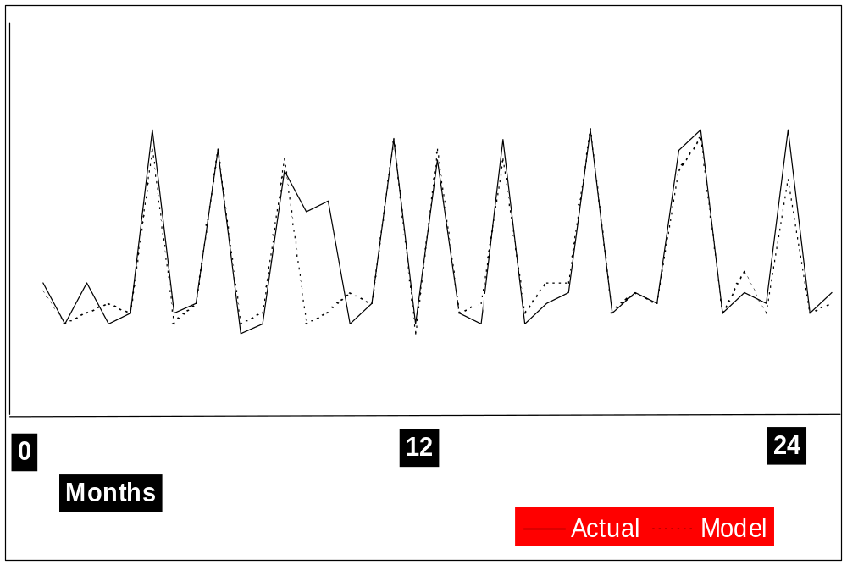
Influence of Four Variables, Taken Together
S
A
L
E
S
17-<number>

Slide 88
A Model Cannot Cope with Unexpected Events
Sales
New Package
Model
Actual
Months
17-<number>

Slide 89
The MKIS in Fortune 500 Firms
Preprocessed information 71% of 1990 firms
Mathematical modeling
  Generally down
  Reason is unknown
  Except for production deletion and advertising media selection
Model use is becoming more balanced
Studies conducted by Li, McLeod, and Rogers
17-<number>
Notes:
27

Slide 90
The MKIS in Fortune
500 Firms [cont.]
Support for management levels
  Models
  Overall
Support for management functions
Support for the marketing mix
17-<number>
Notes:
28

Slide 91
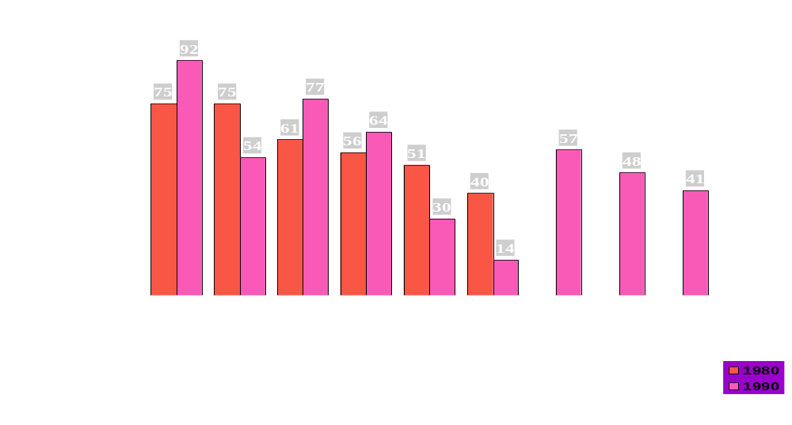

N.A.
N.A.
N.A.
Retrieving Data
Storing Data
Processing Data
1980
1990
Purposes of Computer Usage
17-<number>
Notes:
31

Slide 92
Model Use Is Becoming More Balanced
Strategic planning
level .17
Strategic planning
level .30
Management
control
level
.70
Management
control
level
.54
Operational control
level .13
Operational control
level .16
1980
1990
Note: The percentages are based on the number of respondents
ranking the particular management levels first.
17-<number>
Notes:
32

Slide 93
Overall Support from the Marketing Information System Is Becoming More Balanced
Strategic planning
level
.25
Strategic planning
level
.28
Management control
level
.57
Management control
level
.40
Operational Control
level .31
Operational control
level .17
1980
1990
Note: The percentages are based on the number of respondents ranking the particular management levels first.
17-<number>
Notes:
33

Slide 94
The 1990 Managers Placed More Emphasis on Planning and Less on Directing Than Did
Their 1980 Counterparts
Planning .37
Planning .51
Organizing .03
Organizing .06
Directing .25
Staffing .01
Directing .07
Controlling .34
Controlling .36
1980
1990
17-<number>

Slide 95
Marketing Managers Are Using the Computer More
for Making the Difficult Price and Promotion Decisions
Product .32
Product .49
Price .27
Price .39
Place .16
Place .15
Promotion .08
Promotion .13
1980
1990
Note: The percentages are based on the number of respondents ranking the particular mix functions first.
17-<number>

Slide 96
How Managers Use the MKIS
Subsystem
Integrated
Product Place Promotion Price Mix
Subsystem
VP of marketing X X X X X
Other executives X X X X X
Brand managers X X X X X
Sales manager X X
Advertising manager X X
Manager mktg resrch X X X X X
Manager of product planning X
Manager of physical distribution X
Other managers X X X X X
17-<number>

Slide 97
MKIS Use by Managers
Industry giants are using the computer as a marketing tool
  To learn about consumer needs and wants
  To formulate the marketing mix
  To follow-up on how well mix is received by the consumers
MKIS information output used across the firm
17-<number>

Slide 98
Summary
MKIS
  Input subsystems
    AIS, Marketing Research, Marketing Intelligence
  Output subsystems
    Product, Place, Promotion, Price, Integrated Mix
Operational MKISs consider management and marketing concepts
  Planning is the key
17-<number>

Slide 99
Appendix E
MANAGEMENT INFORMATION SYSTEMS 8/E
Raymond McLeod, Jr. and George Schell
Human Resources
Information Systems
E-<number>
Copyright 2001 Prentice-Hall, Inc.
Notes:
1

Slide 100
Human Resources
Information System (HRIS)
Handles specialized processing concerning firm’s personnel
HR Computerized processing done using human resources information system (HRIS)
Has become as valuable as other CBIS subsystems
E-<number>

Slide 101
HR Function
Originally called personnel
Can be a department or functional area
HR director is often used to describe the person in charge
E-<number>

Slide 102
Primary HR Activities
Hiring
Education
& Training
Terminat-
ion
Benefit
Administration
Recruiting
The Firm
Potential
Employees
Employees
Retired
Employees
Data Management
E-<number>
Notes:
3

Slide 103
The HRIS
The name HRMS (Human Resource Management System) is also catching on in industry
May not always be computer-based
Manages HR data and information
E-<number>
Notes:
4

Slide 104
The Evolution of the HRIS
First, paper files were located in the Personnel department.
Then, punched card and magnetic media files were located in IS.
Government legislation in the 1960s and 70s eventually called management's attention to the importance of HR data.
In the late 1970's the concept of an HRIS was born.
E-<number>
Notes:
7

Slide 105
HRIS Model
Output
subsystems
Input
subsystems
Work force
planning
subsystem
Data Information
Accounting
information
system
Recruiting
subsystem
Internal
sources
Human
resources
research
system
Work force
management
subsystem
Users
HRIS
Database
Environmental
sources
Compensation
Subsystem
Manufacturing
intelligence
subsystem
Benefits
subsystem
Environmental
reporting
subsystem
E-<number>
Notes:
9

Slide 106
Accounting Information Subsystem
Two main types of data
  1. Personnel -- name, birth date, sex, marital status, education, skills, etc.
  2. Accounting -- hourly rate or monthly salary, taxes, insurance deductions, etc.
E-<number>
Notes:
10

Slide 107
Human Resources
Research Subsystem
Examples:
  Job analyses and evaluations
  Succession studies
  Grievance studies
This research can generate new data for the database (job analyses)
And it can use existing database contents (succession studies)
E-<number>
Notes:
11

Slide 108
Human Resources
Intelligence Subsystem [cont.]
Government
  Stay current on legislation
  File reports.
Suppliers
  Employment services
Labor unions, local community, competitors
  Sources of employees
E-<number>
Notes:
12

Slide 109
Human Resources
Intelligence Subsystem [cont.]
Global community intelligence
Financial community
  Employee planning
Competitor intelligence
E-<number>
Notes:
12

Slide 110
The HRIS Database
Type of data:
1. Employee
  82.5% of the firms maintain only employee data
2. Nonemployee
  8% of the firms
  mainly organizations external to the firm
E-<number>
Notes:
14

Slide 111
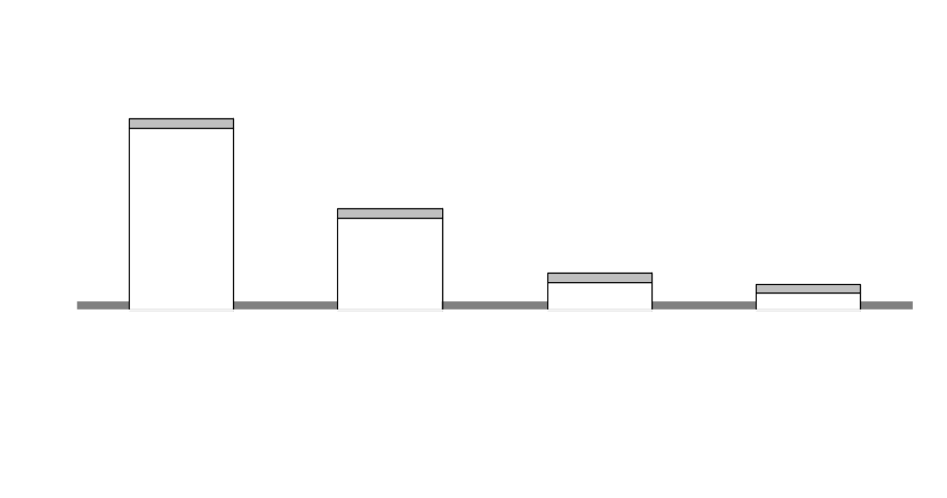
Possible HRIS Database Locations
342
174
52
32
E-<number>
Notes:
15

Slide 112
Database Location
Operating division -- decentralized
Outside service center -- outsourced
Central computer is still the most popular location
Some firms keep database in multiple locations
E-<number>
Notes:
16

Slide 113
Users of the HRIS Database
Non HR
HR
Other HR
Executives
Managers
Director
Managers
(2.78)
(3.09)
(3.79)
(4.33)
0
1
2
1
1
3
4
3
4
5
Not at all
Occasionally
Monthly
Weekly
Daily
E-<number>
Notes:
17

Slide 114
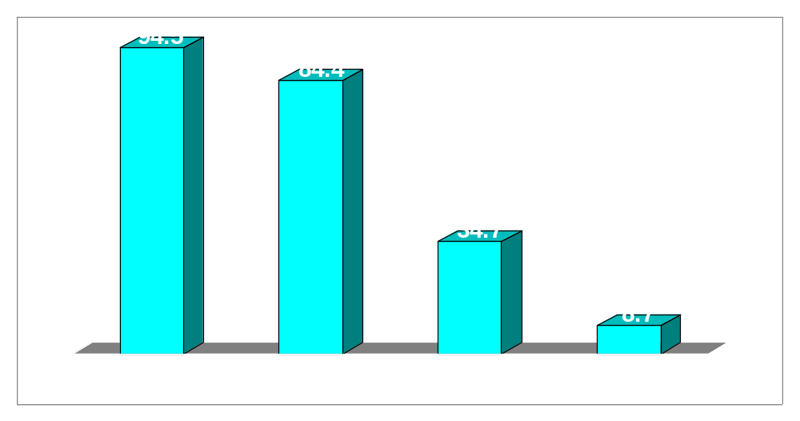
Basic Forms of HRIS Output
E-<number>
Notes:
18

Slide 115
Software
Custom software is usually developed jointly by HR and IS
Some software is integrated into a core HRIS
Some is standalone
E-<number>
Notes:
19

Slide 116
Work Force Planning Subsystem
Enable manager to identify future personnel needs
Organization charting
Salary forecasting
Job analysis/evaluation
Planning
Work force modeling
E-<number>
Notes:
20

Slide 117
Number of Firms Using
Work Force Planning Applications
In Being
  Application name use developed
  ____________________________________________
  Organization charting 238 58
  Salary forecasting 237 47
  Job analysis/evaluation 176 66
  Planning 68 61
  Work force modeling 66 29
  ____________________________________________
  Totals 785 261
Percent applications in use: 75
E-<number>
Notes:
21

Slide 118
Recruiting Subsystem
Applicant tracking
Internal search
Tracking job applicants
E-<number>
Notes:
22

Slide 119
Number of Firms Using Recruiting Applications
Application name In Being
Use Developed
________________________________________
Applicant tracking 235 98
Internal search 111 56
________________________________________
Totals 346 154
Percent applications in use: 69
E-<number>
Notes:
23

Slide 120
Work Force
Management Subsystem
Performance appraisal
Training
Position control -- ensuring that headcount does not exceed budgeted limits.
Relocation
Skills/competency
Succession
Disciplinary
E-<number>
Notes:
24

Slide 121
Number of Firms Using Work Force Management Applications
In Being Application name use developed
_____________________________________________
Performance appraisal 244 60
Training 216 102
Position control 177 108
Relocation 121 33
Skills/competency 115 107
Succession 110 102
Disciplinary 63 39
_____________________________________________
Totals 1046 551
Percent applications in use: 65
E-<number>
Notes:
25

Slide 122
Compensation Subsystem
Most systems in use
  Merit increases
  Payroll
  Executive compensation
  Bonus incentives
  Attendance
E-<number>
Notes:
26

Slide 123
Number of Firms Using
Compensation Applications
In Being
Application name use developed
___________________________________________
Merit increases 404 36
Payroll 389 21
Executive compensation 273 39
Bonus incentives 230 31
Attendance 191 69 _____________________________________________
Totals 1,487 196
Percent applications in use: 88
E-<number>
Notes:
27

Slide 124
Benefits Subsystem
Defined contribution
Defined benefits
Benefit statements
Flexible benefits
Stock purchase
Claims processing
E-<number>
Notes:
28

Slide 125
Number of Firms Using
Benefits Applications
In Being Application name use developed
_____________________________________________
Defined contribution 275 38
Defined benefits 270 47
Benefit statements 234 57
Flexible benefits 195 55
Stock purchase 149 16
Claims processing 88 11
_____________________________________________
Totals 1211 224
Percent applications in use: 84
E-<number>
Notes:
29

Slide 126
Environmental Reporting Subsystem
Reports firm’s personnel policies and practices to the government
  EEO records
  EEO analysis
  Union increases
  Health records
  Toxic substance
  Grievances
E-<number>
Notes:
30

Slide 127
Number of Firms Using
Environmental Reporting Applications
In Being Application name use developed
_____________________________________________
EEO records 402 43
EEO analysis 352 47
Union increases 165 13
Health records 102 41
Toxic substance 80 32
Grievances 66 31
_____________________________________________
Totals 1,167 207
Percent applications in use: 85
E-<number>
Notes:
31

Slide 128
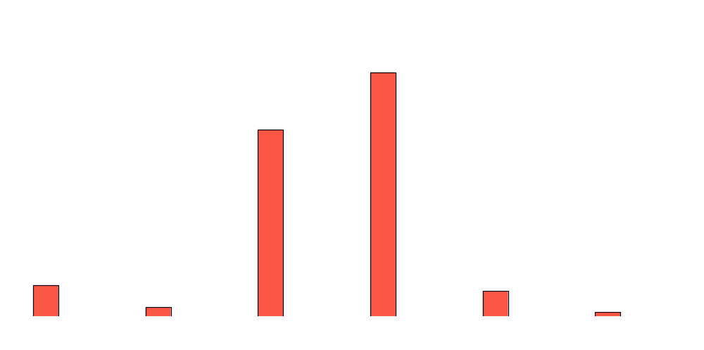
Executive Perception of
HRIS Value
242
185
31
25
9
4
Top mgmt
is unaware
of HRIS
HRIS
has little
value
HRIS is
valued less
than other
systems
HRIS is
valued on a
par with
other
systems
HRIS is
valued
higher than
other
systems
HRIS is
the most
highly valued
E-<number>
Notes:
32

Slide 129
Users of HRIS
Work Force
Management
Compensation
Environmental
Reporting
Work Force
Planning
Recruiting
Benefits
HR director X X X X X X
Other executives X X X X X X
Compensation/benefits manager X X
HR planning manager X
Employee/labor relations manager X X
EEO/AAP manager X X X X X X
Recruiting & selection dvlpmnt mgr X X
Training manager X
Manager of accounting X X
Payroll manager X X
Other managers X X X X X X
E-<number>

Slide 130
Summary
HR function has four primary activities
  Recruiting and hiring
  Educating and training
  Management employee-related data
  Termination and benefit administration
HRIS helps managers manage the personnel resource
Two big influences on HRIS development
  Government
  Microchip
E-<number>

